Slide 1


Slide 2


Slide 3
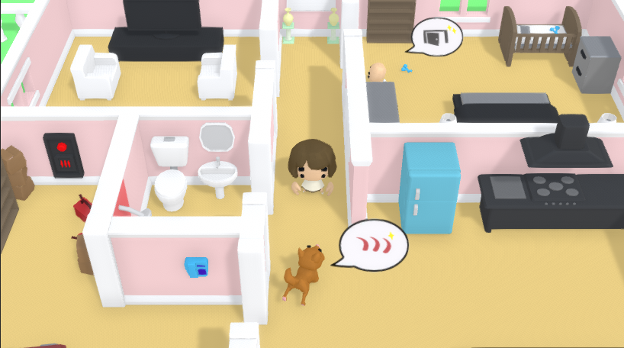

Slide 4
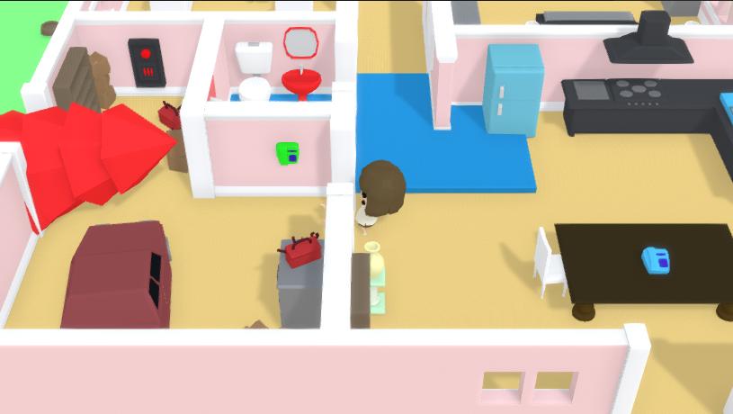

Slide 5
WHY PARENTAL PANIC?
We wanted to move away from handheld gaming.
Had potential as PC/Console Arcade Type game.
Wanted to explore different gameplay mechanics.
  Distracting the baby and the dog.
  Other obstacles that would keep the player occupied.
We received positive feedback, and found we had fun core gameplay that could easily be expanded upon.
Wanted to give the game a visual overhaul.
Stayed with Unity because of existing experience with engine.

Slide 6
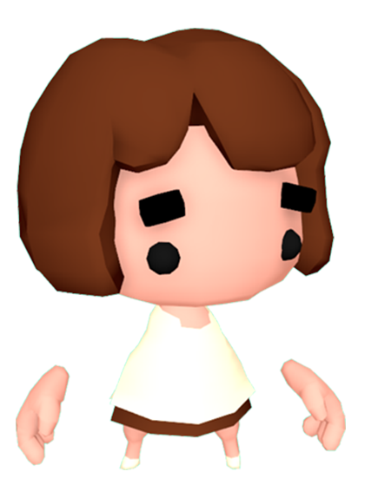
WHAT HAS CHANGED?
Level layout change
  Created with gameplay taken into consideration
New assets added and some old assets have been revisited.
All objects now use the two-tone colour format instead of being flat colour.
All new models and animations for characters.
Improved Main Menu

Slide 7
Game does not end on environment events, instead they increase difficulty.
New Mechanics added.
  Ability to distract and stop both the baby and the dog.
  Sink floods to block off parts of level.
  Tree Now visibly changes level.
  Interactable objects.
Audio Track revisited and edited.
More visual feedback for player e.g. speech bubbles etc.

Slide 8
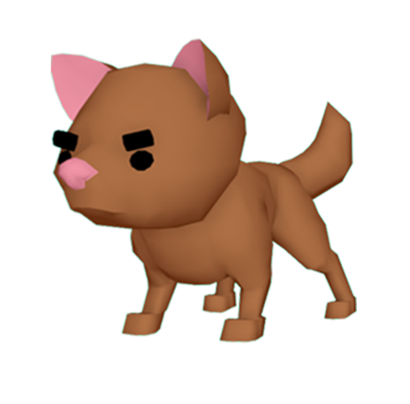
UPS AND DOWNS
Scheduled and delegated work more realistically.
Minimal issues during production
Set proper milestones that the team could follow.
Majority of tasks completed within set time frames
Few minor technical difficulties with SourceTree nearing the completion of the project.

Slide 9
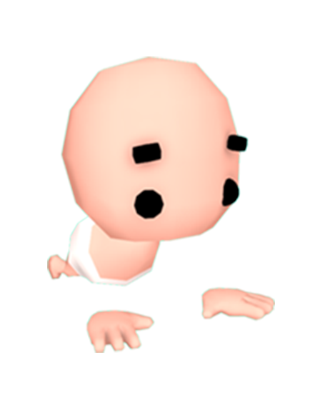
FINAL GAME - CONS
Balancing Issues
Length of game
Providing information for the player in terms of what to do.

Slide 10
FINAL GAME - PROS
Fun and Challenging Core Gameplay
Aesthetically close to what we imagined - not bland flat colours
Not clunky unlike previous iteration.
Polished and closer to a final product.

Slide 11
